Slide 1

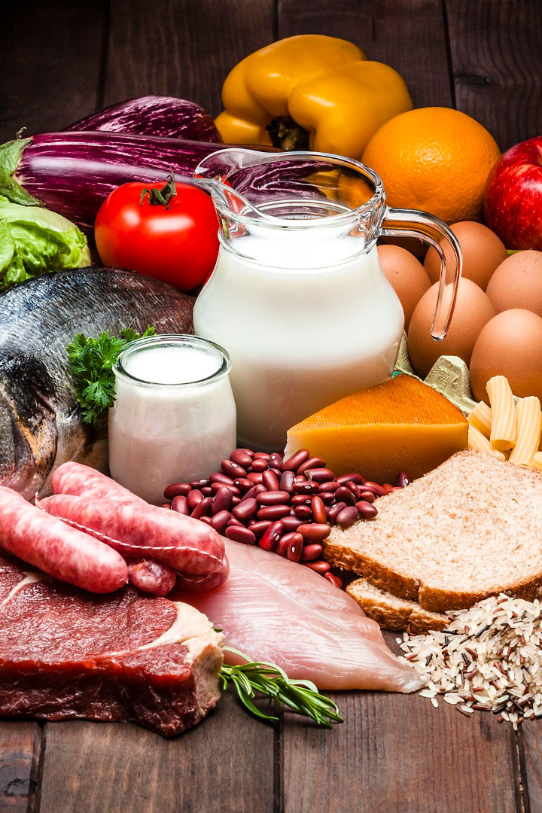
Diet Website: Your Guide to Healthy Living
Welcome to our diet website, your ultimate resource for everything related to healthy eating and nutrition. Discover the importance of maintaining a balanced diet and learn how it can transform your life.
By Siddharth Chaudhary & Ankit yadav

Slide 2

Diet Basics
1
Types of Diets
Explore different dietary approaches such as keto, vegan, and Mediterranean, and understand their principles and potential benefits.
2
Macronutrients & Micronutrients
Gain insight into the importance of macronutrients (carbohydrates, proteins, and fats) and micronutrients (vitamins and minerals) for overall health and well-being.

Slide 3

Recipe Ideas
1
Quick & Healthy Recipes
2
Meal Planning & Batch Cooking
Discover simple and delicious recipes that prioritize nutrition without compromising on taste, making healthy eating a breeze.
Learn effective strategies to streamline your meal preparation and save time, ensuring healthy meals are always within reach.

Slide 4
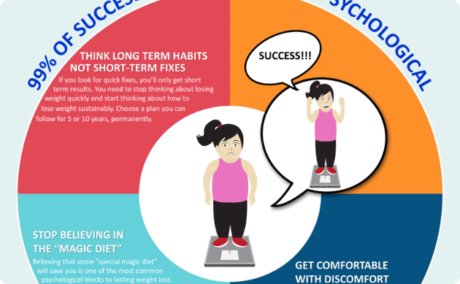

Weight Loss Strategies
Fitness & Exercise
Find practical tips and sustainable approaches to achieve your weight loss goals, including mindful eating and portion control techniques.
Understand the significance of regular physical activity and explore different exercise options tailored to various fitness levels and preferences.

Slide 5

Health & Wellness Tips
Good Sleep & Hydration
Explore strategies for stress management and self-care, such as mindfulness techniques and engaging in activities that promote well-being.
Uncover the benefits of establishing healthy sleep habits and maintaining proper hydration levels to support overall health and vitality.

Slide 6

Conclusion
Recap the key points highlighted throughout this presentation, emphasizing the importance of adopting a holistic approach to nutrition and lifestyle choices. Take the next step towards a healthier you!

